Slide 1
Police Unions and Collective Bargaining Agreements: How Do They Influence The Use of Excessive Force?
Ashley Lofton – Research Methods Term 3

Slide 2
HYPOTHESIS
Police Union membership and policies increase the rates of police use of excessive force
NULL HYPOTHESIS
Police union membership and policies have no effect on the rates of police use of excessive force.
WHY IS THIS RESEARCH RELEVANT?
Union membership and policies seem to play a very large role in the day to day activities within law enforcement agencies, yet seem to be very under studied.
Some union policies create barriers for police chiefs and supervisors to effectively deploy properly trained officers to specific areas.
Disciplinary action against officers. When Unions get involved its often difficult to properly discipline a member. This could be a reason why some of these cases don’t ever get to litigation or prosecution. Union Provides legal support.
Unions are politically active, financially support pro-law enforcement pro-union candidates. With this much control over day to day activities and management within the departments, it is important to understand how these policies effect not only police officers, but the general public as well.

Slide 3
LITERATURE REVIEW
Variables | Author
Race of suspect, Socioeconomics | Mitrani, 2014
Experience, Training & age | Hassell & Archbold, 2010
level of force used by an officer relative to the suspect’s resistance | Alpert, G. MacDonald, J. M , 2001
Organizational Culture, Union Reform | Walker, 2012
Proactivity | Worden,1989
Officer Disposition/Attitudes | Worden,1989
Situational Factors | Worden,1989
Neighborhood Context | Terrill and Reisig, 2003

Slide 4
METHODOLOGICAL DESIGN
Exploratory Content Analysis
Mixed Methods
Will utilize data from the Cato Institutes’ National Police Misconduct Reporting project.
Electronic Survey
Compile data and compare Cato Institutes data with the data acquired from the electronic survey.
GIS software as a visual component to see if higher concentrations of excessive force exist in higher concentration union membership areas.
Selection Process
The proposed content analysis will rely only on the data set from the cases located within the metropolitan Atlanta law enforcement departments.
The electronic survey will be sent to all 628 Metro Atlanta police departments.

Slide 5
DESIGN CONTINUED
Sample Electronic Survey Questions
Is your department associated with a police union?
Is the association related to the department as a whole, or individuals within the department?
How many cases of excessive force are you aware of within your department?
Does your department have specific rules regulating the deployment of less experienced officers to certain areas? If so please explain.
If your department or its members are affiliated with a union, what union policies do you feel are beneficial for your department specifically?
How are cases of excessive force handled within your department?
How are cases of excessive force handled within your department?

Slide 6
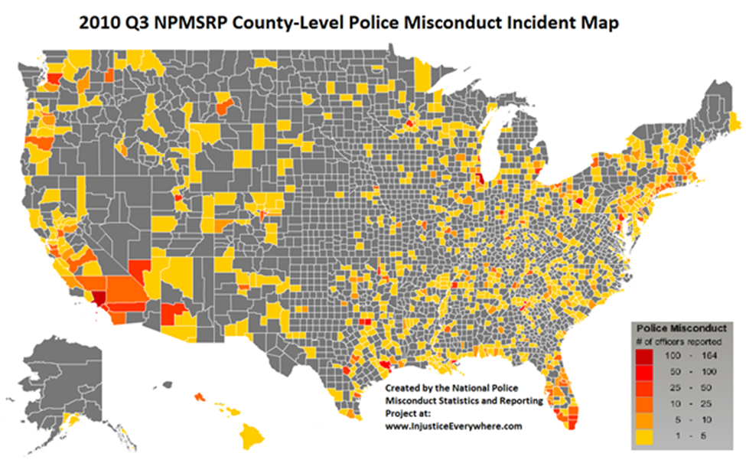
Cato Institute Map of Excessive Force
Example of what GIS generated maps look like.

Slide 7
VALIDITY & LIMITATIONS
The findings are restricted to media sources and we cannot assume these are all accurate. It is also highly unlikely that the media would or could cover all cases of police misconduct and excessive force nationwide
Cato Institute report does not review civil records or criminal court records . This means that some important cases could have been missed that were not reported in the media.
Other limitations to consider are factors that may have played a role in 2010, the year the data was gathered; i.e. economic turmoil such as the recession, highly publicized cases of excessive force and political struggles within the police unions.
The data does not allow for insight as to whether the instances of excessive force are higher or lower in 2010 than in previous years. This is because the report was only generated previously in 2009 and only three quarters of that year can be accounted for in the data.

Slide 8
VALIDITY & LIMITATIONS CONTINUED
The survey section of this research may pose a limitation regarding response rate of the departments. They may be concerned with anonymity or may not want to participate or give information about the union in which they belong in an effort to protect the unions.
This research is not generalizable to other areas or law enforcement agencies other than in metropolitan Atlanta because we are only looking at data and law enforcement agencies in this specific area.

